Slide 1



Slide 2
Phase 1
Ascent
Phasse 2
Descent
Phase 3
On the Ground
Phase 4
Data Elaboration

Slide 3
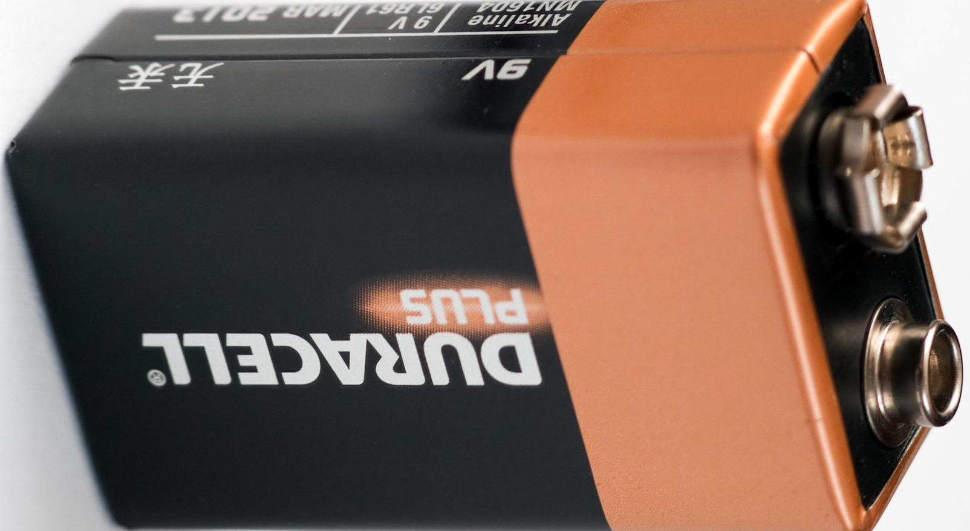
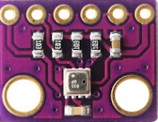
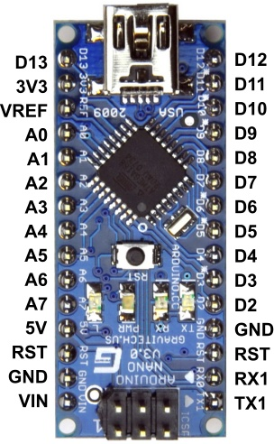
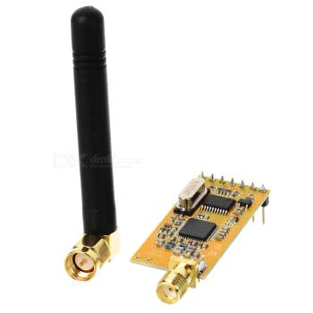

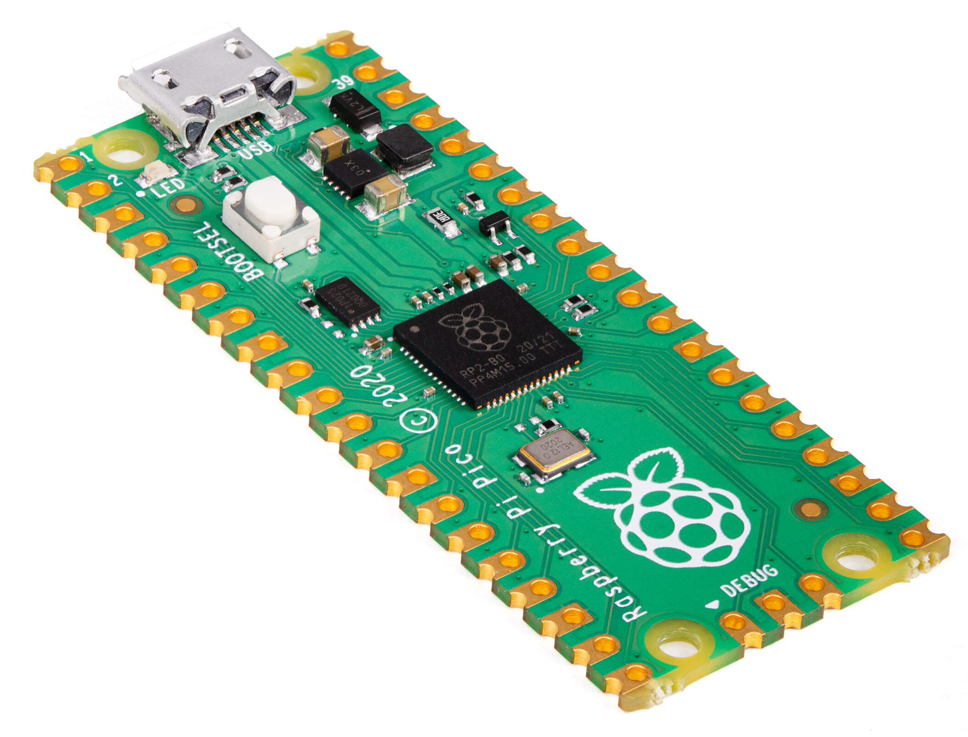
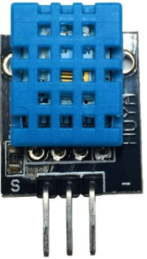

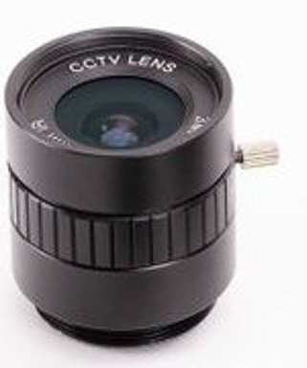



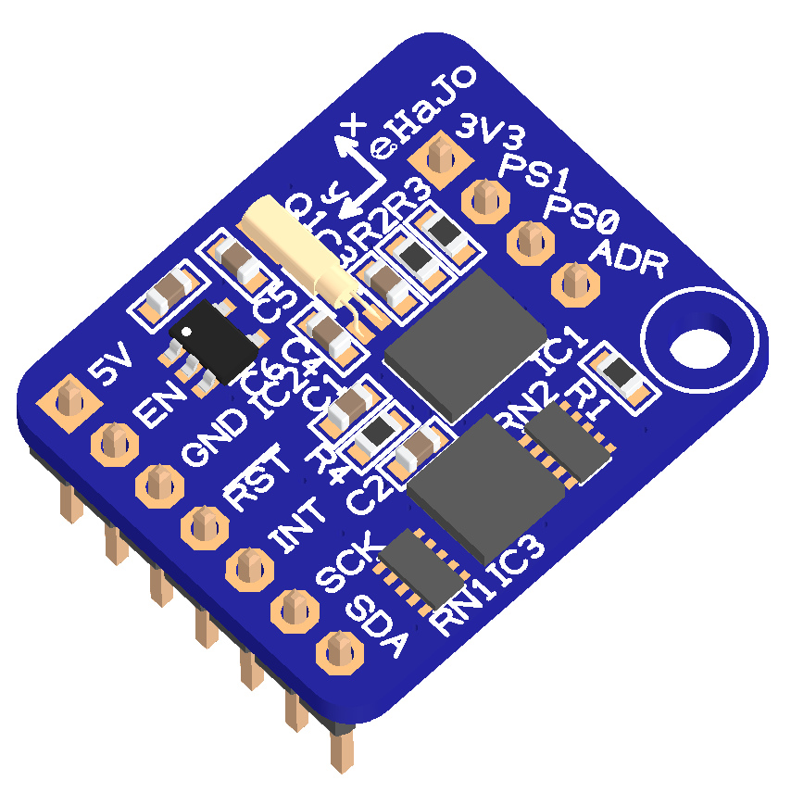


Battery
Pressure
Arduino micro
RF
Transmitter
Raspberry Pico
ML
Accelerator
Temp &
Humidity
HD Camera
RF Receiver +
Arduino UNO
9-axis
sensor
Seeds Exit

Slide 4


UPPER PART
RF transmitter
Static pressure
Temperature
Parachute hook
MIDDLE PART
Microcontrollers
Arduino Micro
Raspberry Pico
9-axis motion sensor
LOWER PART
Seeds tank
Seeds release system
Battery

Slide 5
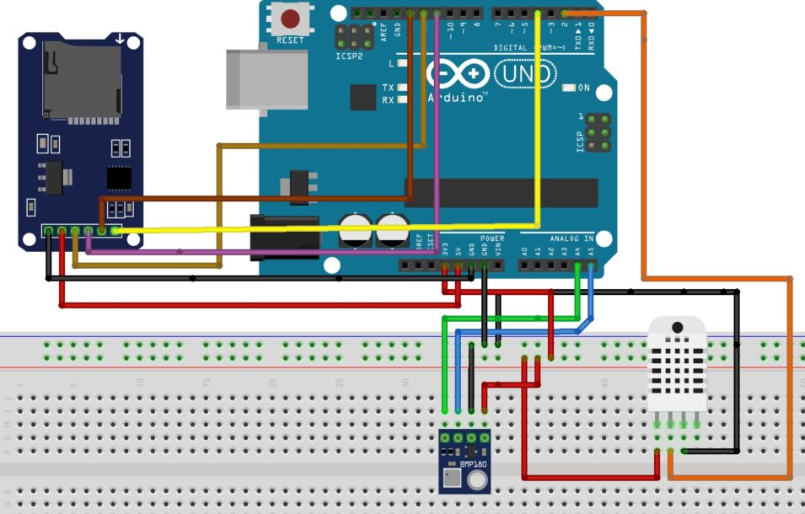
DHT11
Temperature
Humidity
BMP280
Temperature
Pressure
SD Card
Reader/Writer

Slide 6
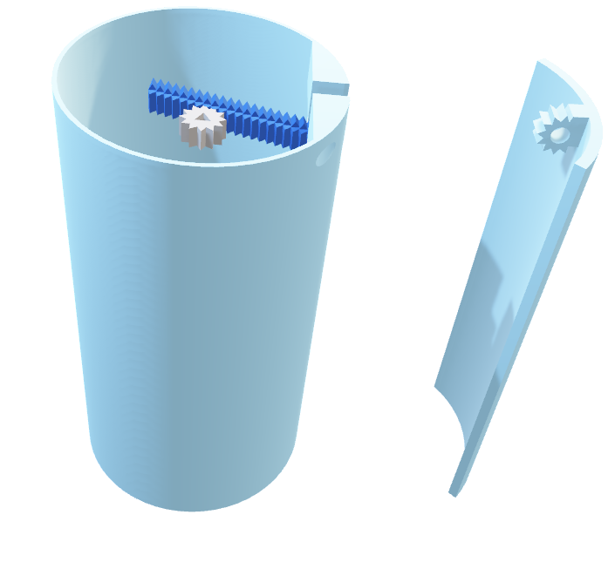

Slide 7
Start
Library initialization
SETUP PHASE
Pin declaration
SD verify
Sensors initialization
Loop initialization
Has the fall started?
Read sensors data
Write data on microSD
Send data via radio
YES
NO

Slide 8

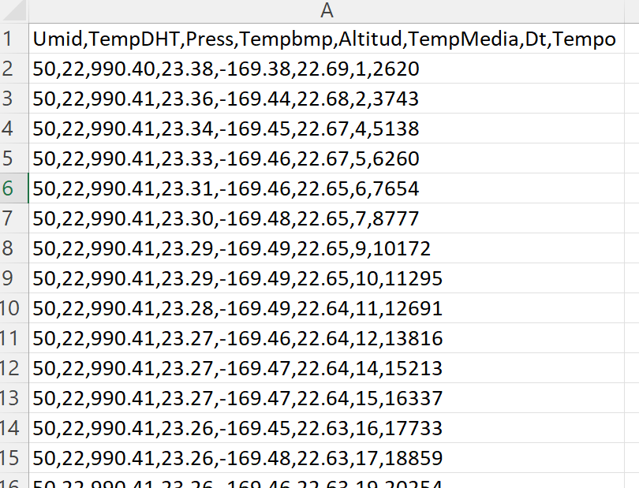
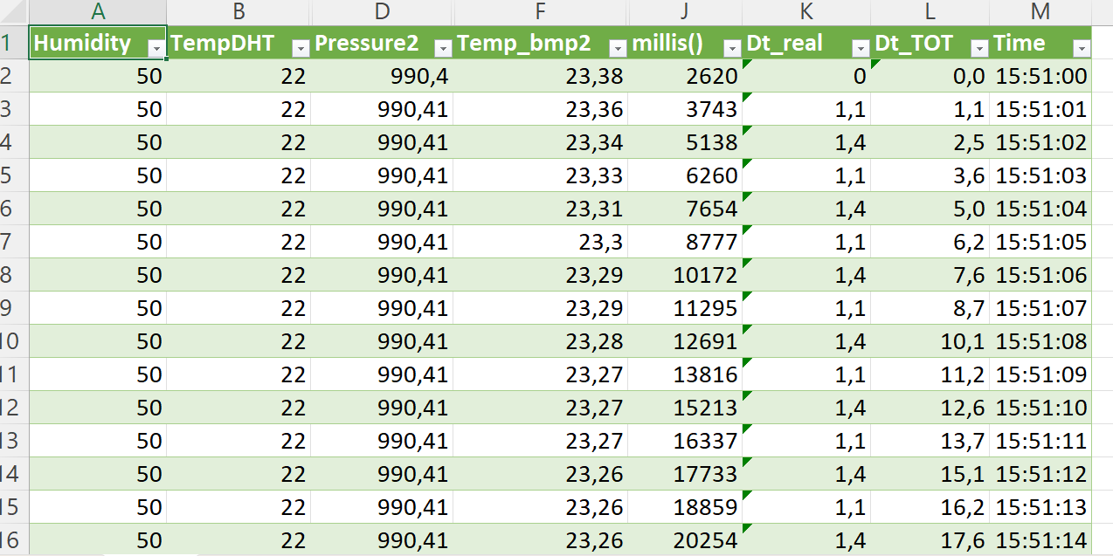
csv
xls
plot

